Slide 1
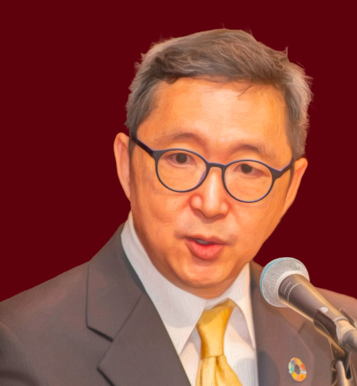

Slide 2
WHAT IS BONSUCRO?
Bonsucro is the leading global sustainability platform and standard for sugarcane
Our purpose is to collectively accelerate the sustainable production and uses of sugarcane.
© Bonsucro
2

Slide 3
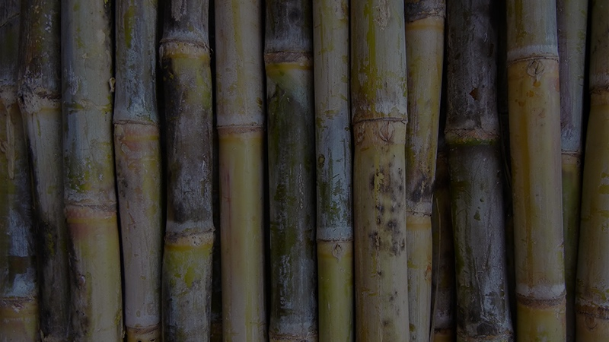
Sugarcane production involves environmental and social challenges
Greenhouse gas emissions
Water use
Forced & child labour
Deforestation
Engaging smallholders at scale
Land rights
Fertiliser & pesticide use
Health & safety
© Bonsucro
3

Slide 4
Bonsucro’s role
We act as a catalyst for transformation. Our purpose is to collectively accelerate the sustainable production and uses of sugarcane.
We convene over 300 members from more than 50 countries…
To address critical challenges –
environmental, social and economic
- in the sugarcane sector
To drive both performance and impact through our system of sustainability standards
Notes:
We’re the largest & most comprehensive membership network of sugarcane-related businesses with a focus on sustainability in the world

Slide 5
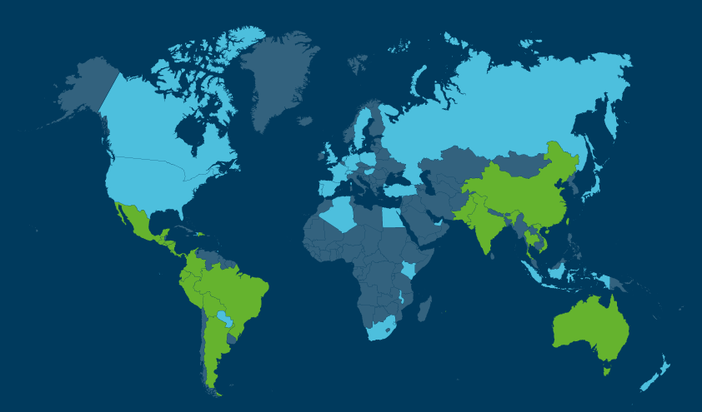
Bonsucro Worldwide
Europe
Members: 51
24 Chain of Custody certificates
Asia
Certified mills: 34
Members: 67
47 Chain of Custody certificates
The Americas without Brazil
Certified mills: 28
Members: 84
49 Chain of Custody certificates
Pacific
Certified mills: 7
Members: 12
10 Chain of Custody certificates
Brazil
Certified mills: 82
Members: 64
101 Chain of Custody certificates
Africa & the Middle East
Certified mills: 2
Members: 19
7 Chain of Custody certificates
Data from July 2023
Notes:
Correct as of??

Slide 6
Mills
Farmers
Refiners
Our members
NGOs
Traders
End users
Notes:
Who are we?
We are part of a powerful global drive towards more sustainable food systems.
We are fortunate to have in membership some of the worlds biggest consumer goods companies, and sugarcane producers.
Currently we have more than 300 members from more than 55 countries –and all along the supply chain from farms, mills, distilleries, traders, manufacturers and retailers. We also are benefit from a small but influential group of NGOs in membership.
In terms of our sector reach, an estimated 20% of sugar buyers and 25% of sugar producers sit within our membership.
They join Bonsucro because they are committed to work collaboratively with their peers on a journey of continuous improvement – to scale up and accelerate change across a wide range of extremely complex issues in agriculture global value chains.

Slide 7
What we do
Standards & Assurance
Assist farms and mills with sustainability
Offer digital tools for use
Invest in impact projects
Market Development
Support members through regional teams
Collect and analyse data
Drive collective action

Slide 8
The three pillars of sustainability
Good stewardship of natural resources
Creating economic value across the supply chain
Caring for people
and communities
Notes:
Economic – Raw material production is a business, and businesses need to be profitable for all the actors across the value chain.
Social
Production relies on peoples and communities. The supply chain should improve livelihoods and working conditions to ensure healthy societies and workers.
Environment
Good stewardship of natural resources is fundamental for maintaining the production of raw materials. Every small change in the environment can represent a big risk to production in the future.

Slide 9
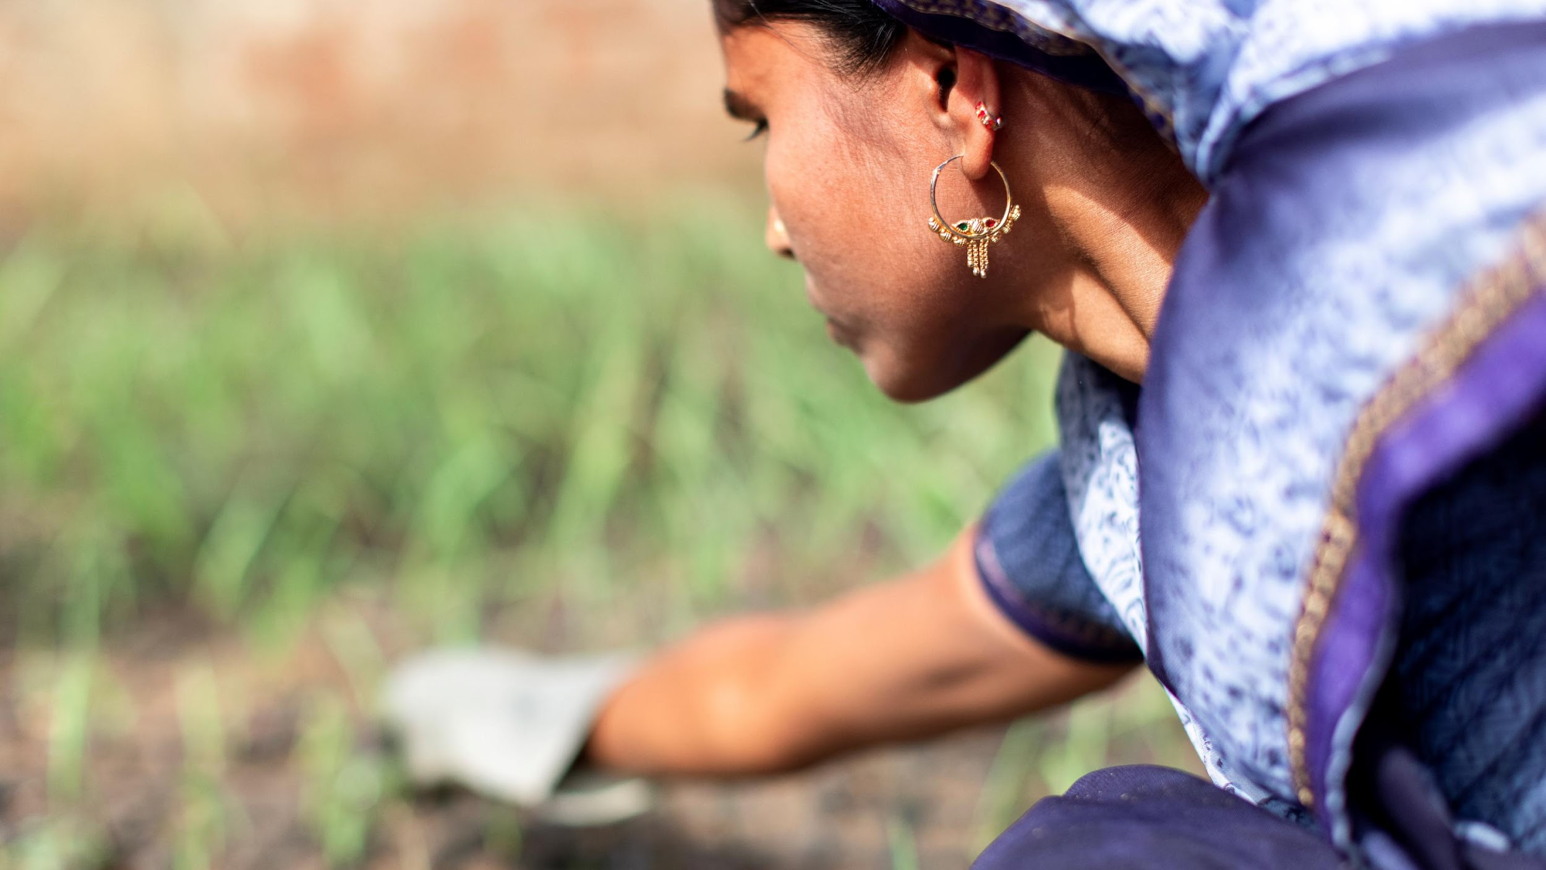
BONSUCRO STRATEGY: CHANGING FOR GOOD 2021-2026
Contributing to our strategic aims

Slide 10
Bonsucro’s strategic intent for 2021-26
Notes:
The strategy is built around a newly defined Purpose
To collectively accelerate the sustainable production and uses of sugarcane
and three Strategic Aims – which align to the 3 pillars of sustainable development and define how we will contribute to the SDGs
The 3 Aims are inter-dependent and non-hierarchical.
For each Strategic Aim – we have set high level Objectives, suppored by targets and indicators
Implementation will be designed around five strategic Priorities - in light blue
and delivered through six Activity workstreams- in green
underpinned by four core Principles - in orange
.

Slide 11
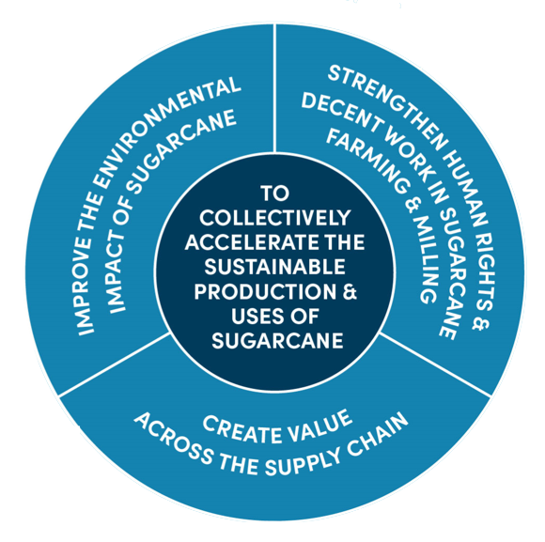
Bonsucro’s strategic aims for 2021-26

Slide 12
Strengthen human rights & decent work
Background
The Bonsucro Code of Conduct calls on all members to respect human rights in their sugarcane supply chains. Growing spotlight on social and labour aspects of sugarcane supply chain
Objectives
Increase wages in the sugarcane farming and milling Improve occupational health and safety Enhance respect for human rights.
Targets
23%/43% reduction in accidents in certified farms after 5 years’ certification. 30%/45% increase in average differential between wages paid above legal minimum wage in mills after 5 years' certification. Collective commitments and actions on Living Wage, Collective commitments and actions to promote UN Guiding Principles on Human Rights
Notes:
We know that:
There is a growing spotlight on social and labour conditions in global supply chains and on corporate due diligence
Much of the world’s sugarcane is grown in countries with below optimal agriculture working conditions
Bonsucro standard provides a framework for producers to improve and certification enables members to reduce risk and to keep pace with market, regulatory, investor and consumer demands for sustainability
Proof that
Bonsucro-certified mills demonstrate no child labour, forced labour or discrimination and after 5 years of certification, operators achieve significant lower accident rates
As a global average, wages on certified farms are significantly above the national minimum wage.
And that we have baked accountability into our assurance system – including a new ‘ground-breaking’ Grievance Mechanism
We want to
Drive Decent Work and safer working conditions for farmers and workers including zero tolerance for forced labour and child labour
Ensure safe recruitment for migrant workers, reduce discrimination in all its forms and promote gender equality.
Promote fairer wages for the lowest paid people in farming and milling through piloting living wages in specific origins. We will do this through collective initiatives – working willing members and partners.

Slide 13
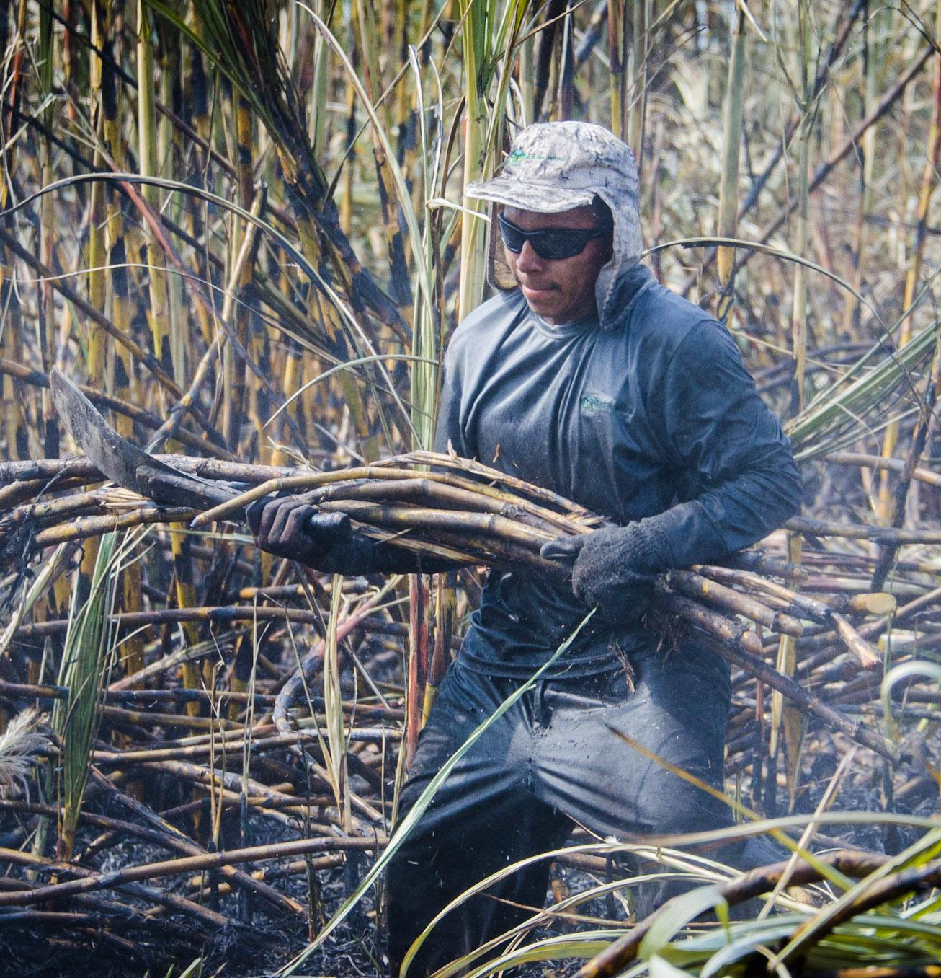
Protecting human rights is a
challenge for sugarcane sector
A lot of the world’s sugarcane is grown in countries with significant social and labour challenges, which include:
Access to personal protective equipment
Adequate sanitation
Insufficient wages
Forced or child labour
Workers can be vulnerable to human rights violations due to:
Lack of other job opportunities
No contract to protect rights or regulate working conditions
Payment terms are by piece/volume cut

Slide 14
Protecting human rights is a
challenge for sugarcane sector
Sugarcane is a global industry with different production conditions, cultural norms, regulatory frameworks, production practices and actors
The supply chain is long and complex
Sugarcane brings slim margins for profit – and there is significant price volatility for derivatives such as sugar and ethanol

Slide 15
Migrant Workers
Finding employment cutting sugarcane during the harvest is relatively easy
there are fewer job opportunities
workers are recruited informally
Migrant workers are particularly vulnerable to exploitation
forced/child labour
no access to education
lack of decent housing or healthcare
Notes:
Migrant workers may also have limited rights in some regions, exposing them to human rights violations

Slide 16
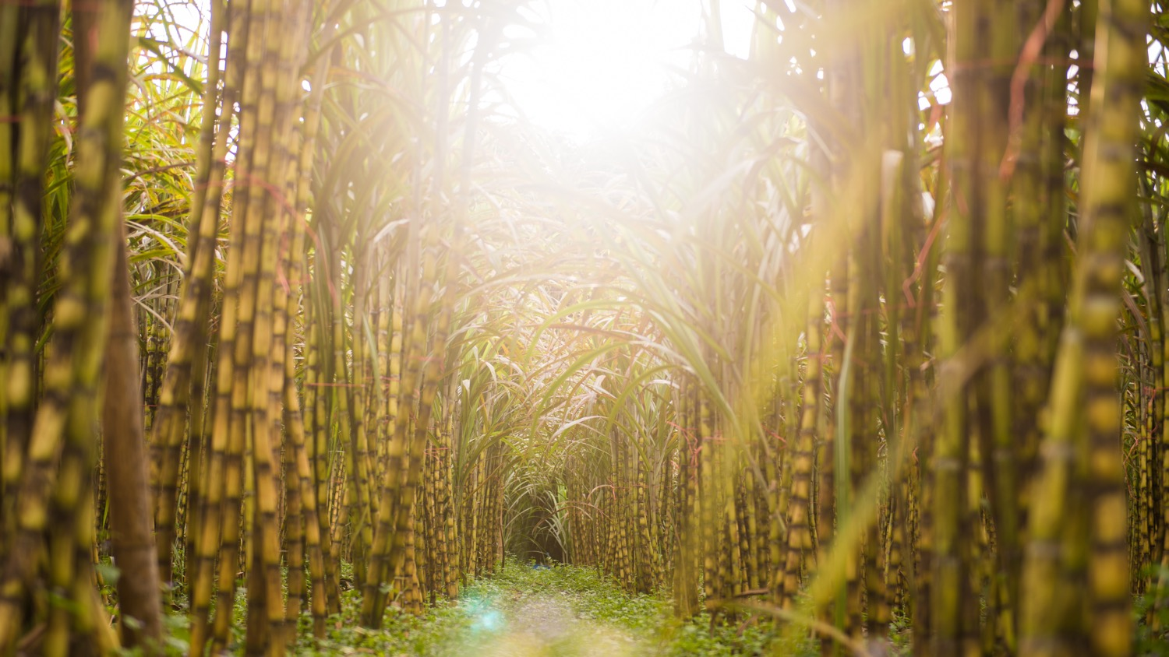
CERTIFICATION AS A TOOL FOR PROMOTING HUMAN AND LABOUR RIGHTS

Slide 17
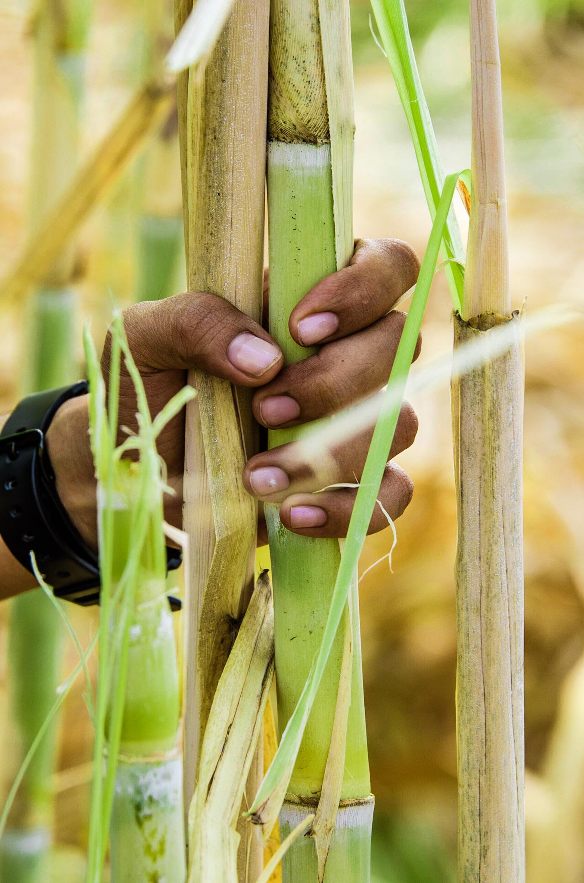
Addressing human rights and promoting decent
work requires a comprehensive strategy
For Bonsucro, this means offering our members and partners: ​
A member Code of Conduct that promotes continuous improvement around respecting human rights​
A Production Standard that references international frameworks and which is regularly updated to reflect evolving norms and best-in-class practices​
A robust and transparent assurance and certification procedure that can be trusted​
An accessible grievance mechanism​
Capacity building programmes (training, Bonsucro Impact Fund projects, impact projects)​
Facilitating and funding collective action initiatives

Slide 18
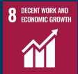
Certification as a tool for promoting
human and labor rights
The Bonsucro Production Standard provides a roadmap to best social practices, with metrics and protocols for auditing:
National law compliance​
Mitigation of child labour, forced labour, discrimination​
Salary above minimum wage​
Safe and healthy programs​
Reponses for emergencies​
Water, shade and rest protocols

Slide 19
What is the Bonsucro Impact Fund?

Slide 20
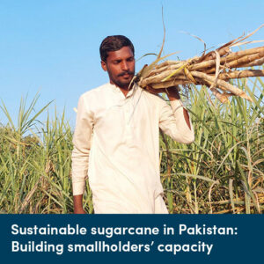
Investing in innovative projects at sugarcane origins
The Bonsucro Impact Fund supports projects that address critical sustainability challenges in the sugarcane sector.
Using income from the Bonsucro Credit Trading Platform, our Fund offers our members the chance to apply for thematic grants for projects that catalyse sustainable sugarcane production.

Slide 21
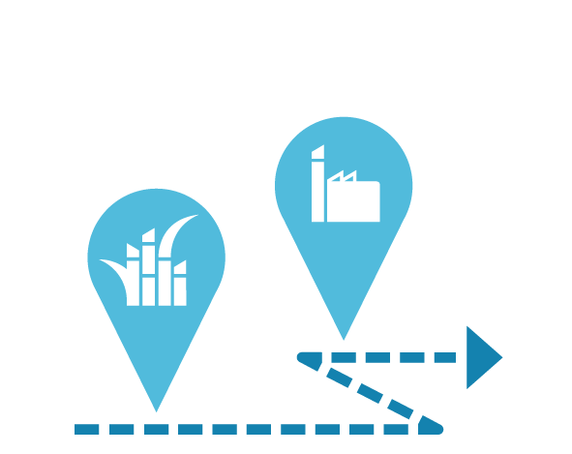
Bonsucro Credits…
…reward Producers
…drive Impact
…facilitate Buying
Certified mills and farms that have been through the Bonsucro certification process are rewarded for their commitment to sustainability
A portion of fees from Bonsucro Credit sales are invested directly into the Bonsucro Impact Fund, which supports projects that collectively accelerate sustainable sugarcane production.
Bonsucro Credits support buyers to achieve their sustainable procurement targets.
© Bonsucro
21

Slide 22
Where do the funds come from?
Credits have been brought by global brands and traders who have Bonsucro membership, including:

Slide 23
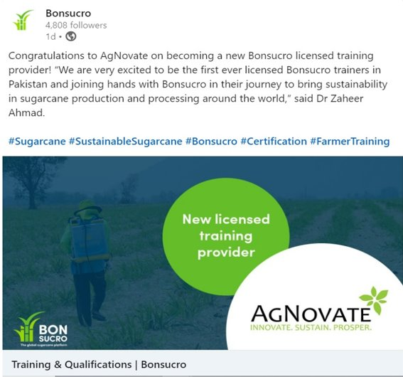
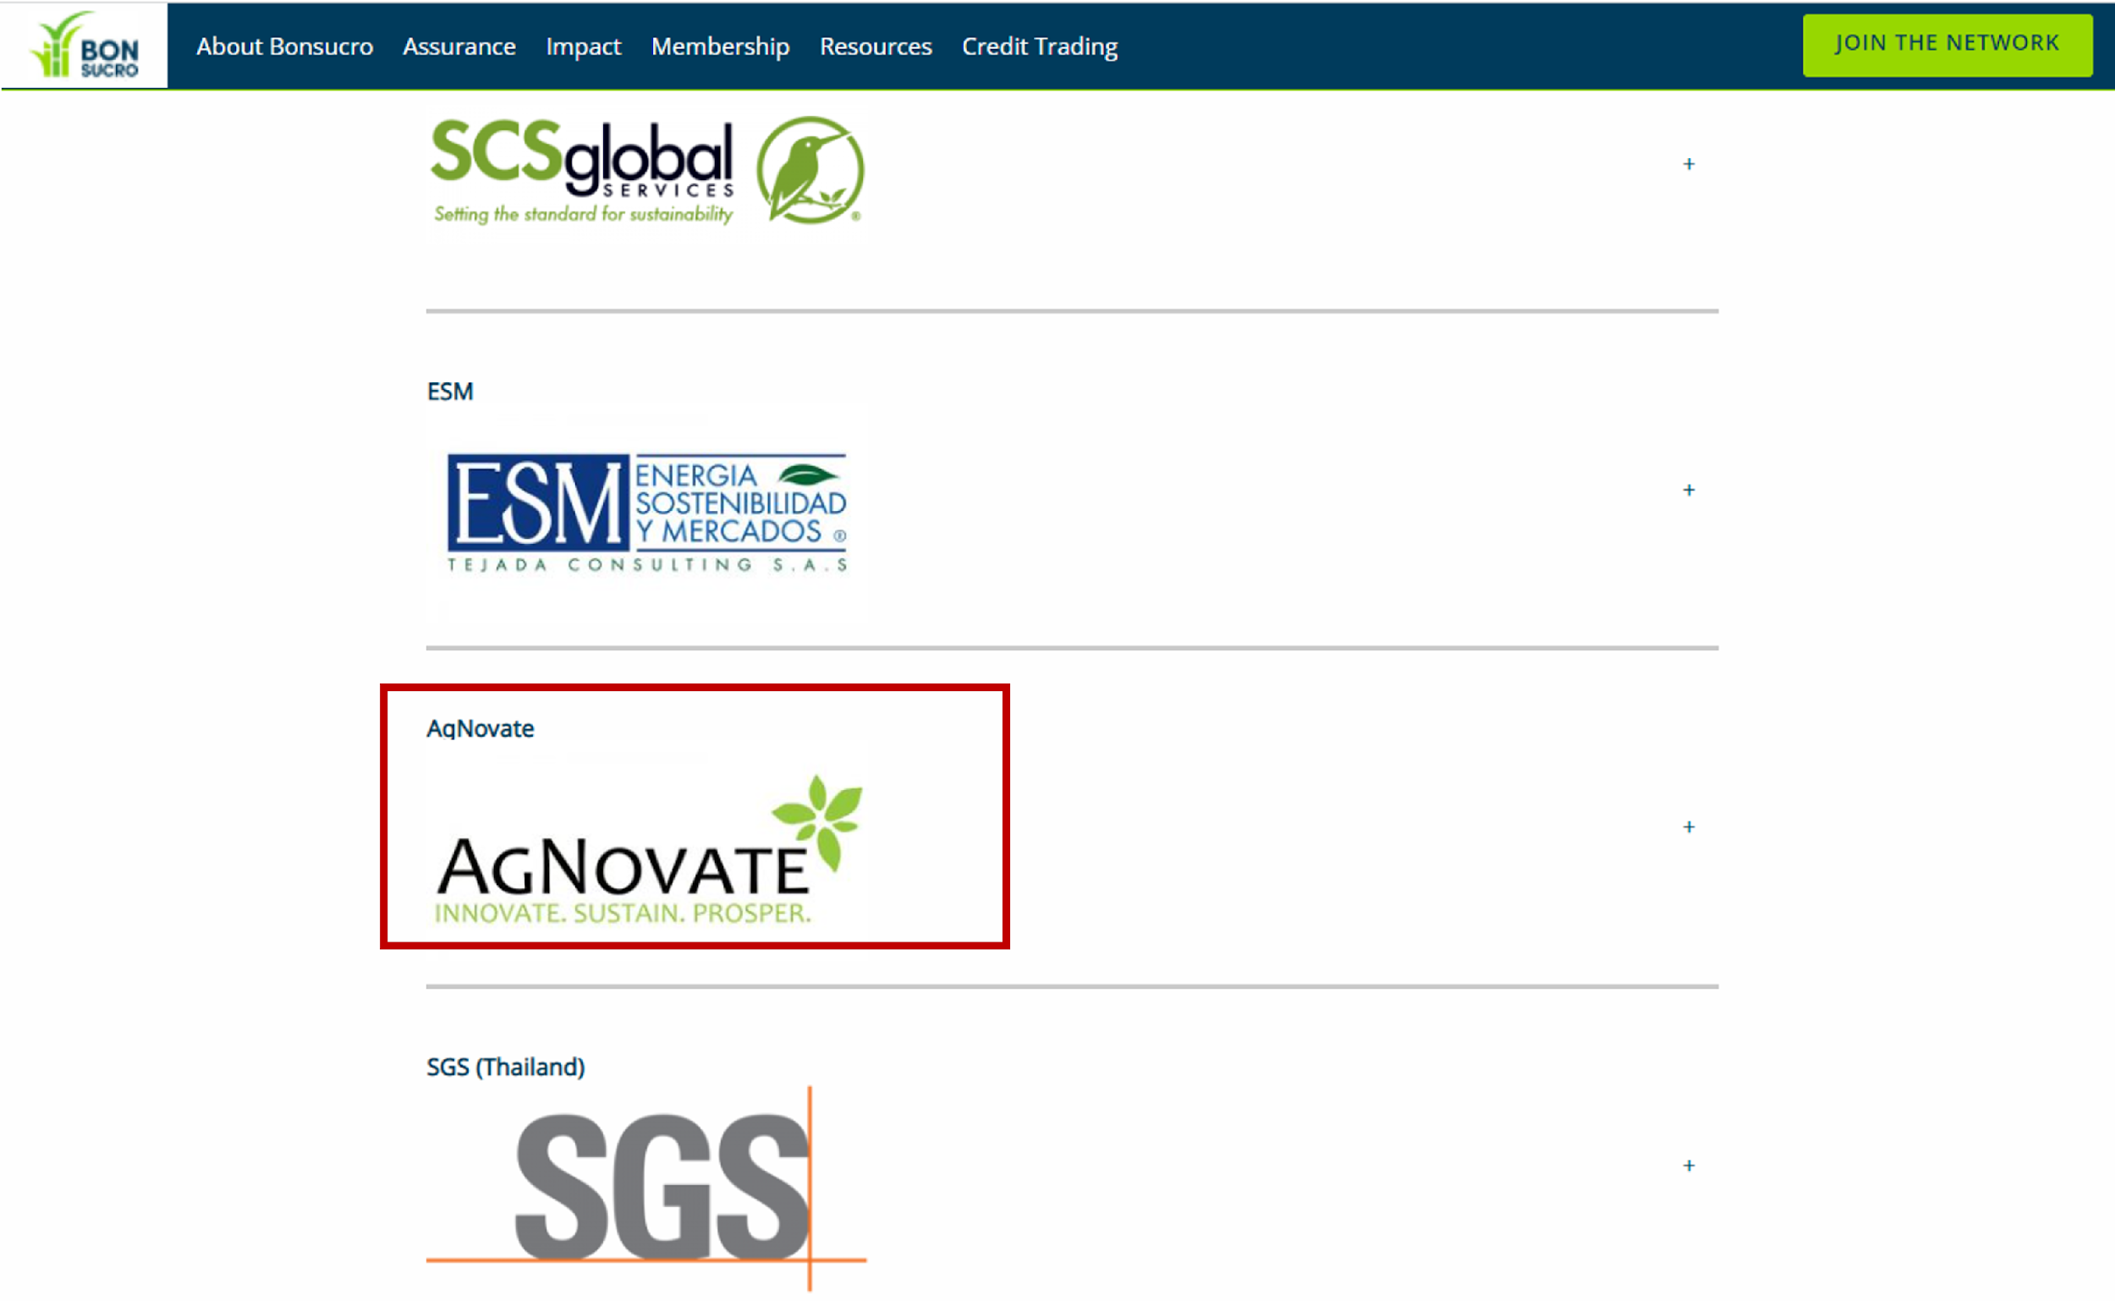
First ever Licensed Bonsucro Training Organization in Pakistan

Slide 24
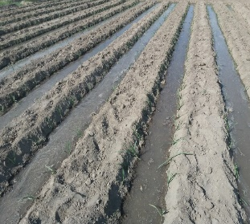
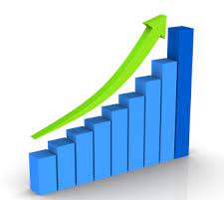
Crop Improvement Program – SW Sugar Mills
Major Components
Training and discussion sessions
Field Trials
Effect of elevated level of P and split dose of K on sugarcane yield and quality with proper Soil Management strategy using recommended dosage of Gypsum ​
Stage-based care of crop against pest and nutrient deficiency
Agri Team’s capacity building
Develop, validate, implement and scale-up ‘Saline Agriculture’ approach for sugarcane cultivation in SWSML supply chain
Scale-up of good practices
Objectives
To test effectiveness of soil management using gypsum with balanced dosage of P and K according to growth requirements of plant
To test the effect of moving more N application to Seedling and Tillering, and decreased N application during grand growth on cane vigor and as a measure to control lodging
Concept of sowing techniques for problematic conditions
Collar sowing
Raised bed nursery
Pit Plantation
Pest scouting and diagnostics

Slide 25
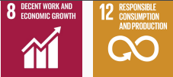
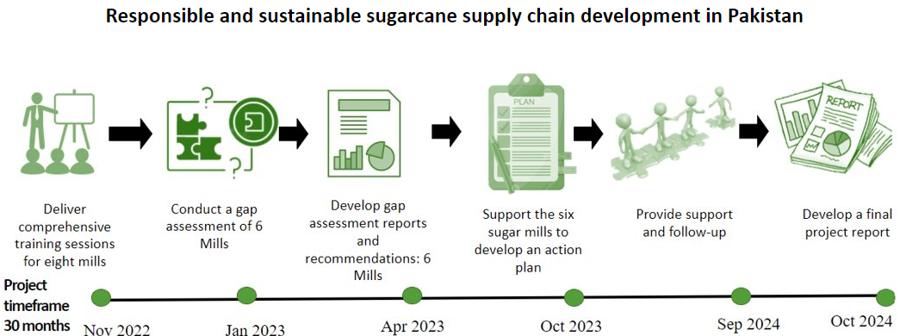
Bonsucro-Coca-Cola_Pakistan Project

Slide 26
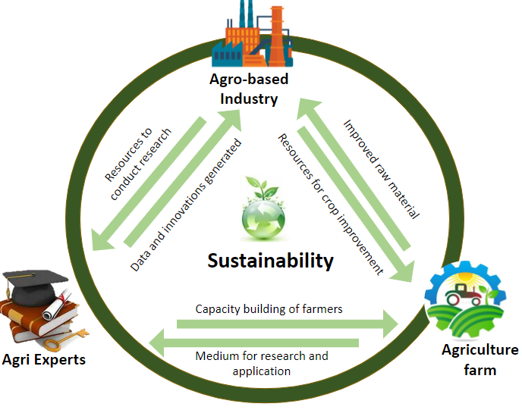
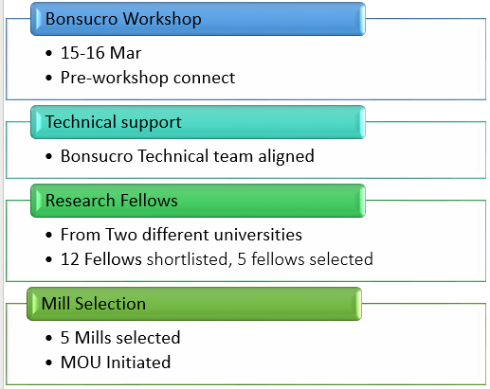
Local Bonsucro Expert on Pep+ Agricultural Transformation

Slide 27
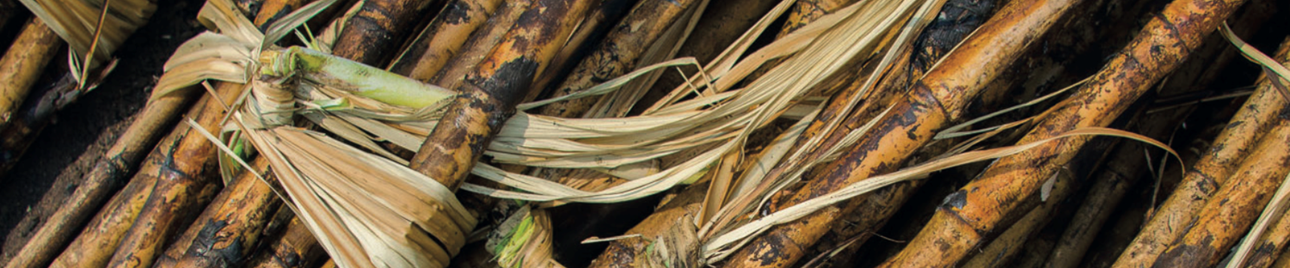
Thank You
Contact Email: thirach@bonsucro.com
Website: bonsucro.com
LinkedIn: Bonsucro
Twitter: @Bonsucro
Notes:
* Please add own contact email to the slide

